Slide 1
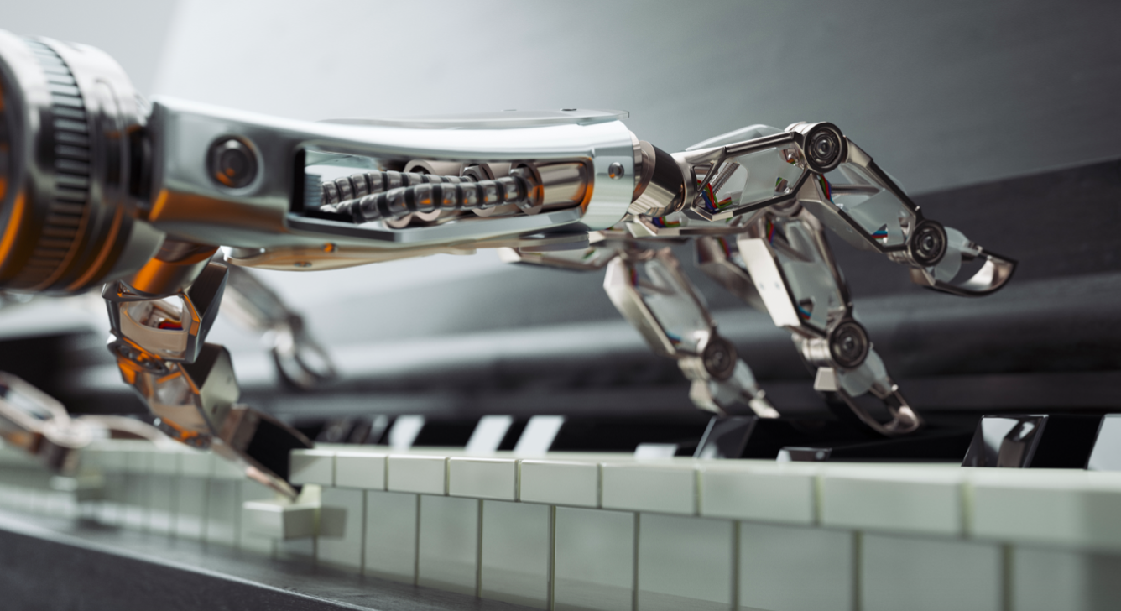
MUSIC GENERATION
Week 1
Notes:
Picture is super low-res LMAO; replace with a better image!

Slide 2
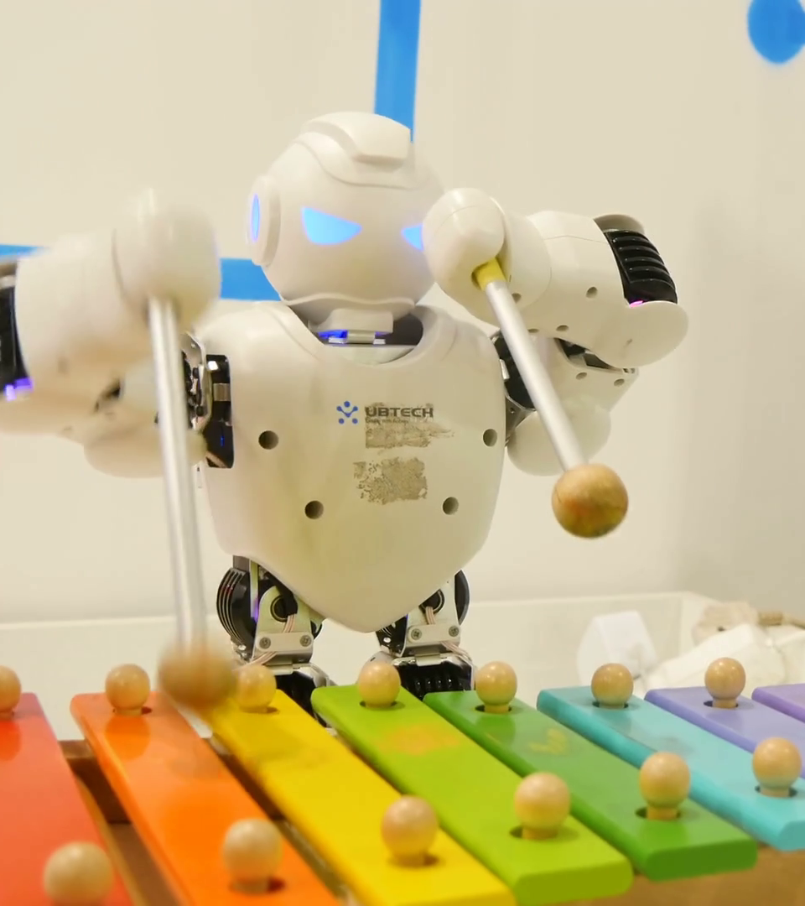
OUTLINE
Introductions
Project Briefing
Setting Up
Intro to ML (Part 1)
Questions?

Slide 3

HELLO FRIENDS!
Share your name, major, year, and favorite place to eat (around here)!

Slide 4
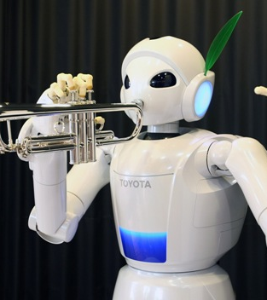
PROJECT OUTLINE
Understanding and Set Up
Cleaning and Building Data Sets
Training the Model
Finalizing and Creating
Notes:
TALK about goals here or smthing?
Familiarity with ML, enough so that you are equipped to be able to work on your own to research on internet and build things?

Slide 5


Time to set up!

Slide 6
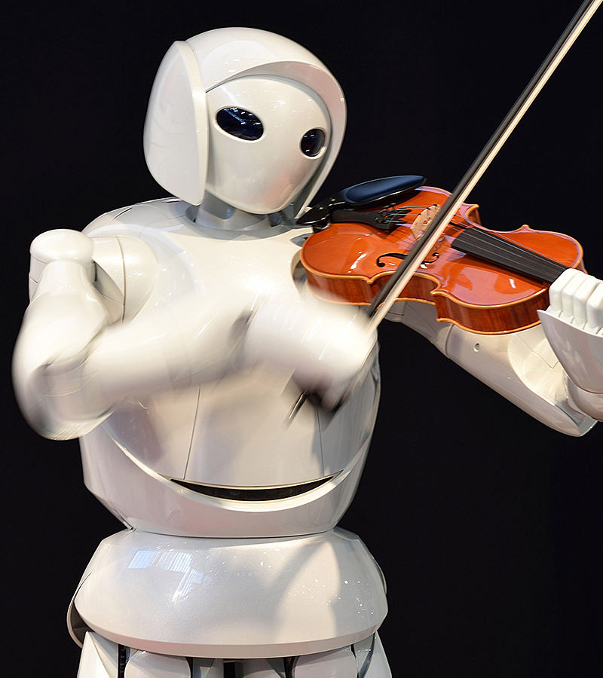
What we will be using!
Google Colab Notebooks
Colaboratory is a free Jupyter notebook environment that requires no setup and runs entirely in the cloud.
Melody RNN
A RNN model that applies language modeling to melody generation using an LSTM.
3 configurations, of which we will be using basic!
Reinforcement Learning (as opposed to Supervised Learning)

Slide 7
The collab notebook for this week
OPEN AND MAKE A COPY!!
LINK

Slide 8

Your turn:
What do you know about Machine Learning?
*buzz*
Notes:
Ask them for examples of ML they know, what they think it is / how it works, etc.. BIG BUZZ WORD BUT WHAT IS IT **REALLLy* ??

Slide 9
What is Machine Learning?
A lot of math
CAPTCHA conspiracy
It has implications with AI, Deep Learning
Same thing as AI?
Self driving cars
ML security + it can be abused?

Slide 10
WHAT IS MACHINE LEARNING?
= the idea that there are generic algorithms that can tell you something interesting about a set of data without you having to write any custom code specific to the problem. Instead of writing code, you feed data to the generic algorithm and it builds its own logic based on the data.
-- Medium article by Adam Geitgey

Slide 11
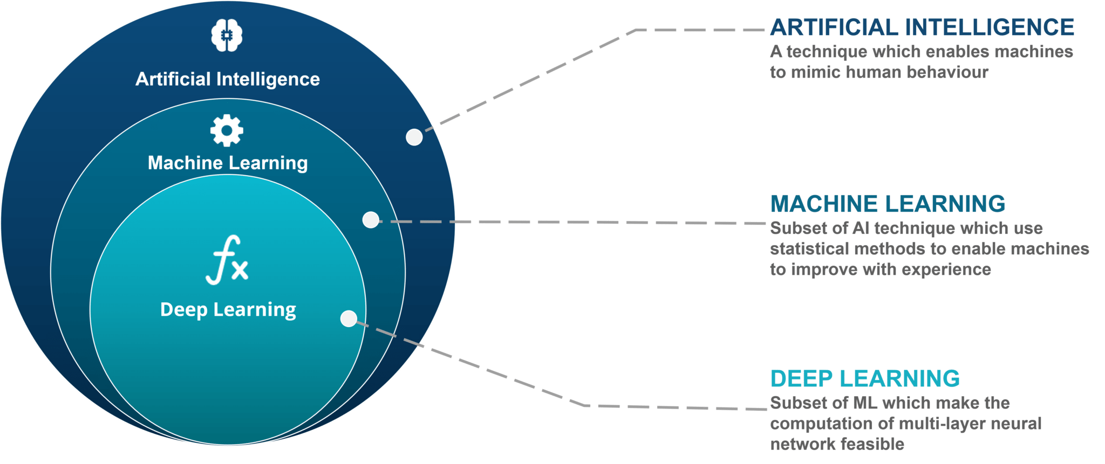
WHAT IS MACHINE LEARNING?
Notes:
Artificial intelligence is the study of agents that perceive the world around them, form
plans, and make decisions to achieve their goals. Its foundations include mathematics,
logic, philosophy, probability, linguistics, neuroscience, and decision theory. Many
fields fall under the umbrella of AI, such as computer vision, robotics, machine learning,
and natural language processing.
Machine learning is a subfield of artificial intelligence. Its goal is to enable computers
to learn on their own. A machine’s learning algorithm enables it to identify patterns in
observed data, build models that explain the world, and predict things without having
explicit pre-programmed rules and models.

Slide 12
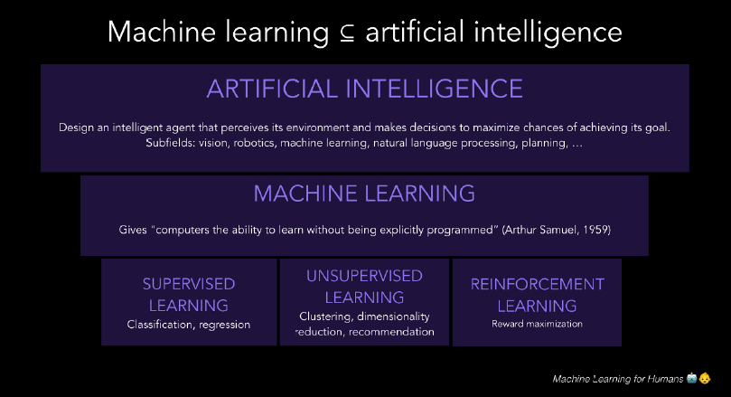

Slide 13
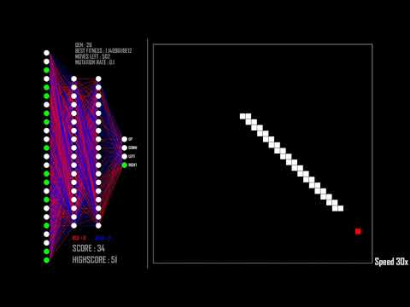
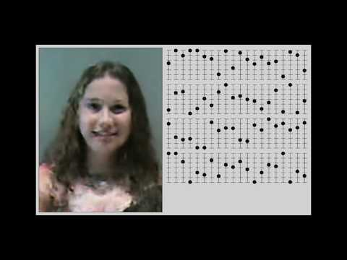
And more such as: spam filtration, virtual personal assistants, video surveillance, plasma physics, etc!

Slide 14
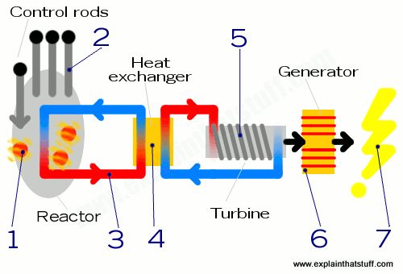
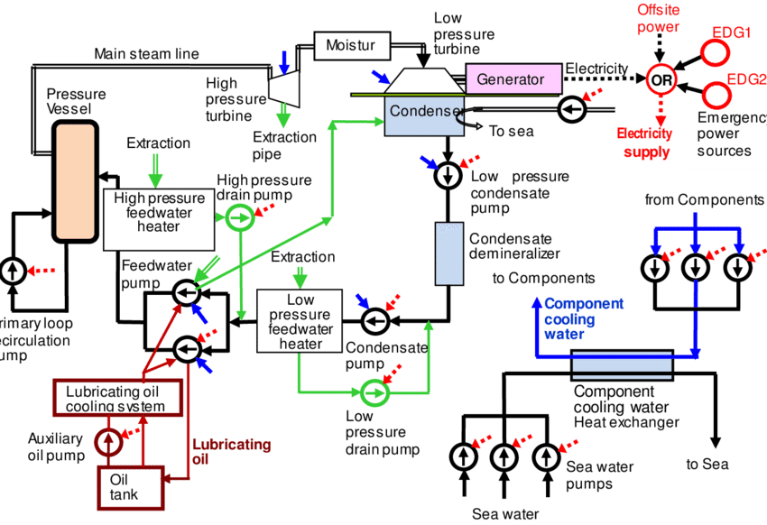
Using Models
A model is a simplification of reality. You want it to be general enough that it can accurately describe more than just a handful of examples of what it's supposed to represent.

Slide 15
Typical Steps
Acquire Data
Choose a model
Evaluate Model Performance
Prep / Visualize Data
Train model on training set
Tune Model Hyperparameters
Prediction
1
2
3
4
5
6
7

Slide 16
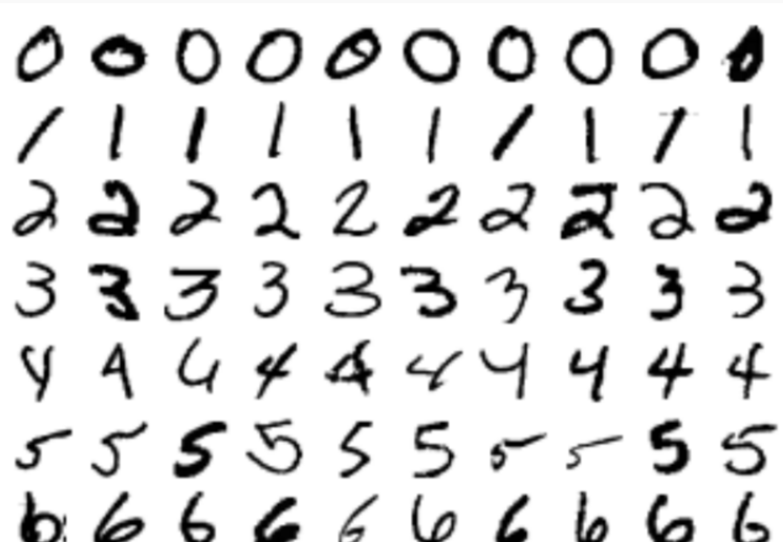
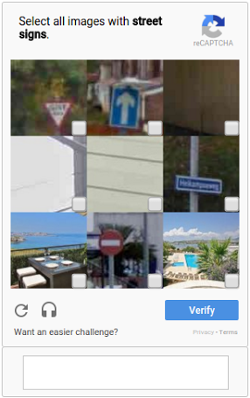
Acquire Data

Slide 17
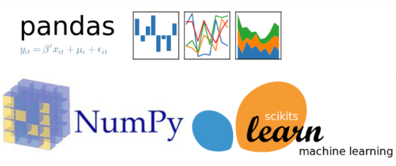
2. Prepare Data

Slide 18

3. Choose a Model

Slide 19
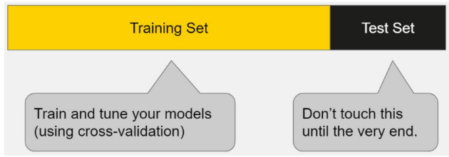
4. Train Model on Training Set &
5. Evaluate Model Performance &
6. Tune Model Hyperparameters

Slide 20
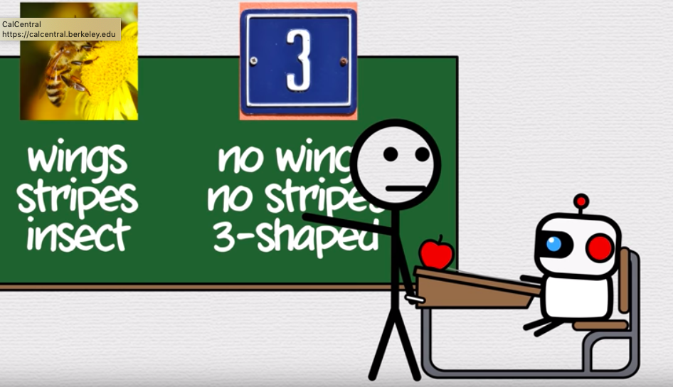
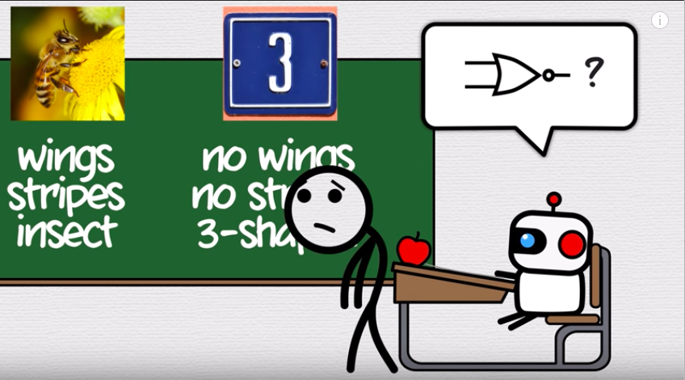
4. Train Model on Training Set

Slide 21
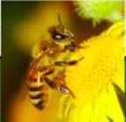
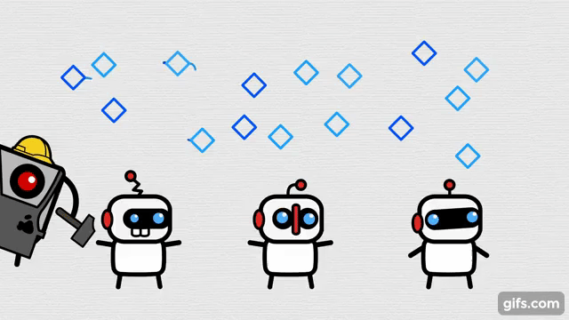

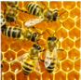
4. Train Model on Training Set
Our code

Slide 22
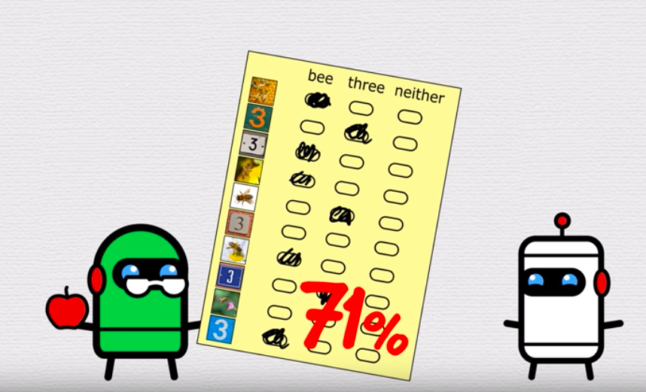
5.Evaluate Model Performance
Our labeled data
Our model
Our code
Our model’s
performance

Slide 23
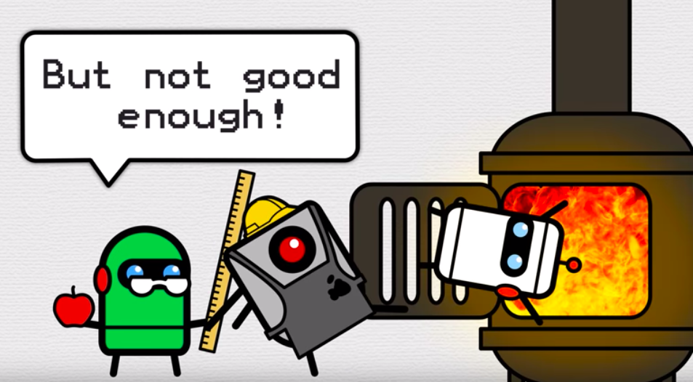
6. Tune Model Hyperparameters to create a better model

Slide 24
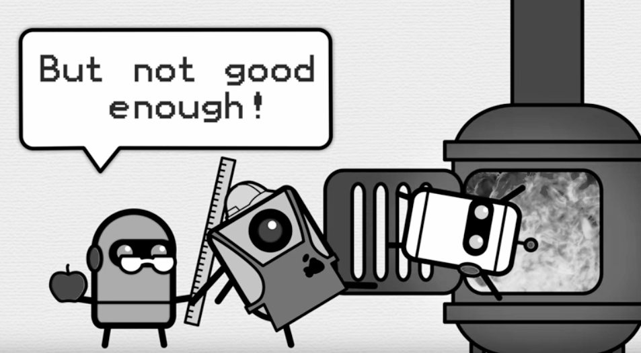
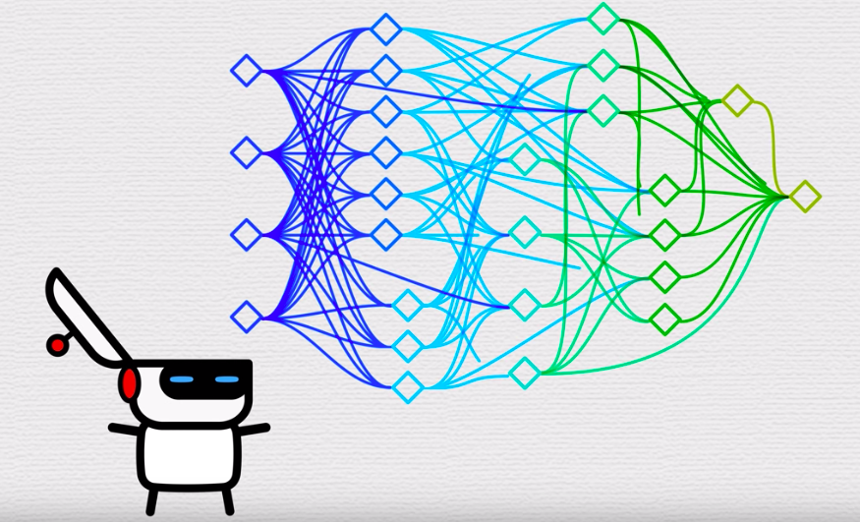
6. Tune Model Hyperparameters to create a better model
(training data set)

Slide 25
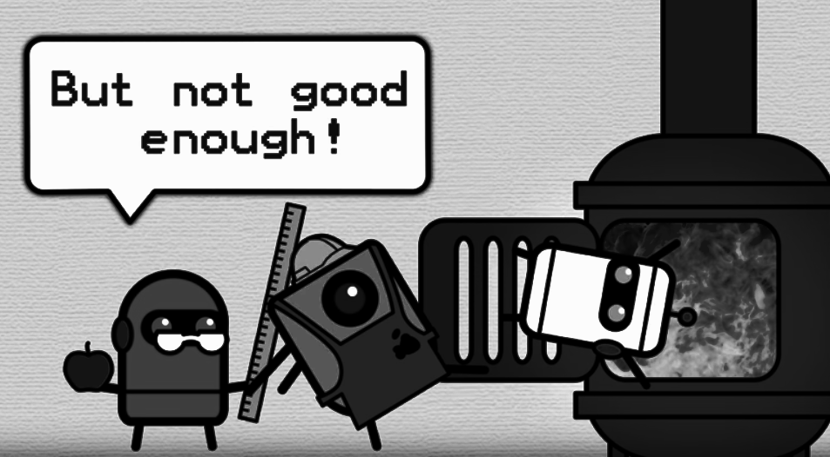
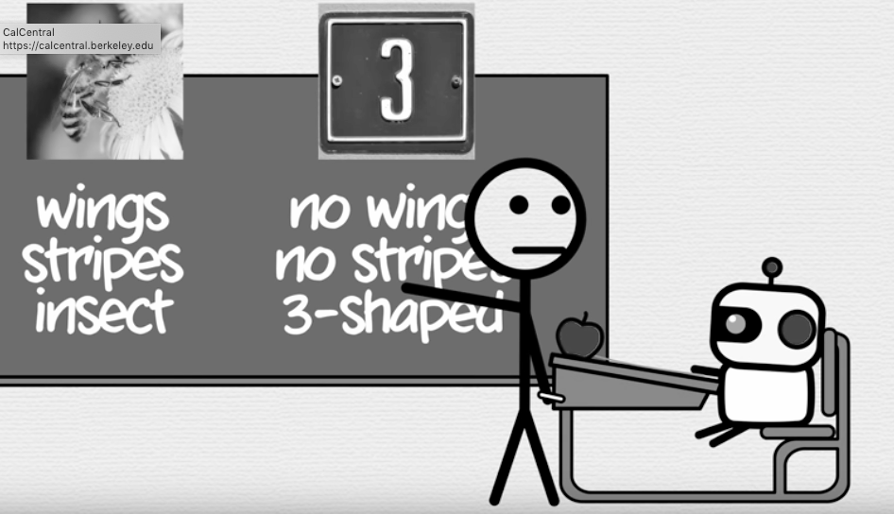
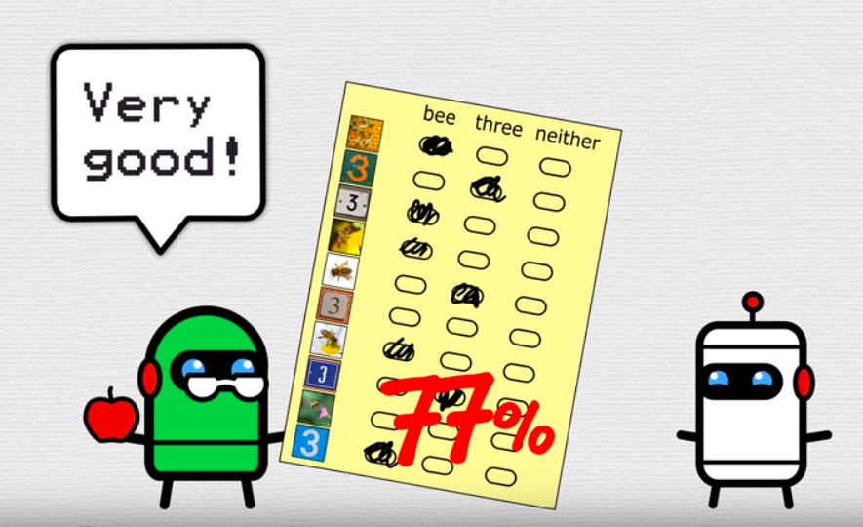
6. Tune Model Hyperparameters to create a better model
6. Tune Model Hyperparameters to create a better model
(test data set)

Slide 26
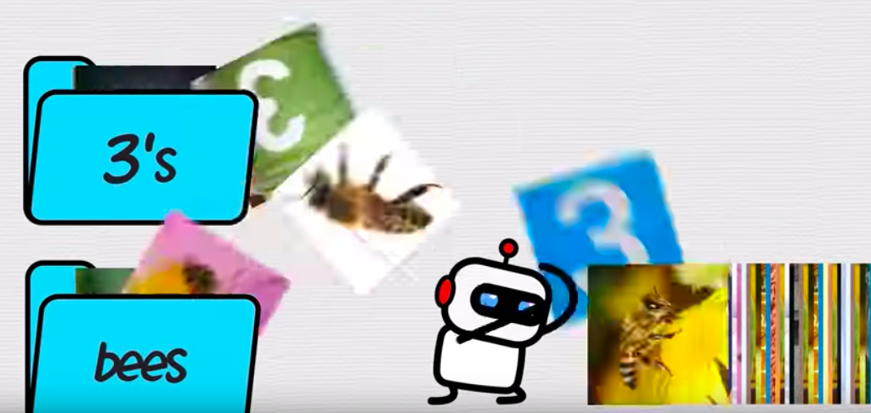
7. Prediction on new data set

Slide 27
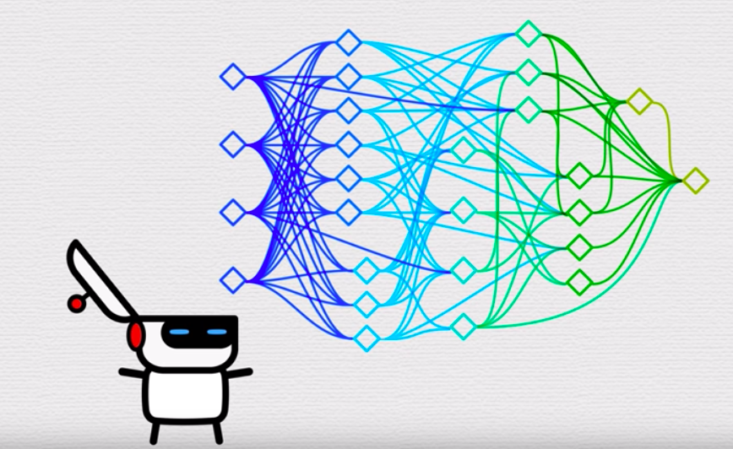
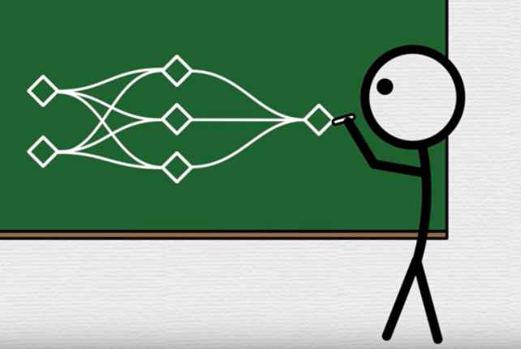
Our Code:
The model:

Slide 28
(Skip) Typical Steps Summary
Acquire Data
Prep/Visualize Data so that your data can be processed by your the libraries/code you use
Choose a model - decide on a machine learning method
Train Model on training set - run your code on your training data using the method you chose
Evaluate Model Performance - use your model your test data set
Tune Model Hyperparameters - retrain your model and adjust things like how much you weight the importance of certain features or how fast you allow the model to change and retest the model until you are satisfied
Prediction - apply your model to new data and use it to do cool things!

Slide 29
HW/DEMO - for extra learning
This collab notebook will reintroduce concept of models and introduce linear regression, which we will be learning next week:
OPEN AND MAKE A COPY!!
LINK

Slide 30
Summary
What we did this week
Intros
Basics of ML
What you have to do:
Work through the demo: link
Resources
Cpg - “How machines learn” - https://www.youtube.com/watch?v=R9OHn5ZF4Uo

Slide 31


THANKS!
Any questions?
Feel free to Slack/FB Message us!
See you next week!
Alma Stacy Pineda
Jennifer Xiao

Slide 32
SlidesCarnival icons are editable shapes.
This means that you can:
Resize them without losing quality.
Change line color, width and style.
Isn’t that nice? :)
Examples:

Slide 33
😉
Now you can use any emoji as an icon!
And of course it resizes without losing quality and you can change the color.
How? Follow Google instructions https://twitter.com/googledocs/status/730087240156643328
✋👆👉👍👤👦👧👨👩👪💃🏃💑❤😂😉😋😒😭👶😸🐟🍒🍔💣📌📖🔨🎃🎈🎨🏈🏰🌏🔌🔑 and many more...

